Slide 1
Block Diagram
Clean / Noisy
Sample
1 sec
STFT
Mel
sepctrum
LSTM
LSTM
Batch Normalization
Linear
Linear
Inverse
Mel
spectrum
Amplitude masking
Loss
Noisy amplitude
Noisy Phase
iSTFT
Metric
Clean Amplitude / Phase

Slide 2
Default Setting
Total number of dataset | 84249 , 1 seg segmentation
Normalization | z-score
Segmentation Normalization | Entire wav file
FFT normalized by fft size | True
Loss function | Phase sensitive approximation
Dense normalized method | glorot_uniform
Batch size | 512
LSTM layer | 256
Batch Normalization after LSTM layer | True
metric: loss function, SISDR
every epoch consists of 1000 step filled with dataset
- If 2048 samples is divided by 64/256 batch, dataset can be divided as 8, 4 case.
- Then it will filled until 1000 steps - After "preprocess include stft" and "process stft during training", it keeps to use time sample data, not stft

Slide 3
Result
 |  | Loss Function |  |  |  | Dataset Split ratio(Train : Valid) |  |  |  | Dense |  | Time period of Normalization |  | Batch size |  | Batch Norm
 |  | rmse (stft) | mse (stft) | psa | rmse (mag) | 90:10 | 80:20 | 70:30 | 50:50 | uniform | normal | entire | 1 sec | 512 | 64 | O | X
Train | Loss at Convex (1e-3) | 2.3468 | 0.1329 | 1.8917 | 1.953 | 1.8917 | 1.9003 | 1.8947 | 1.9023 | 1.8917 | 1.8963 | 1.8917 | 1.85544 | 1.8917 | 1.904 | 1.8917 | 1.9194
 | SISDR at Convex | 14.96 | 14.51 | 14.98 | 14.87 | 14.98 | 14.95 | 14.97 | 14.9 | 14.98 | 14.96 | 14.98 | 14.93 | 14.98 | 14.73 | 14.98 | 14.89
Valid | Loss at Convex (1e-3) | 2.4419 | 0.1390 | 2.0022 | 2.0677 | 2.0022 | 2.0222 | 2.0537 | 2.0824 | 2.0022 | 2.0023 | 2.0022 | 1.971 | 2.0022 | 1.9721 | 2.0022 | 2.0355
 | SISDR at Convex | 14.71 | 14.42 | 14.73 | 14.68 | 14.73 | 14.71 | 14.65 | 14.63 | 14.73 | 14.74 | 14.73 | 14.68 | 14.73 | 14.64 | 14.73 | 14.67
 | Epoch at Convex 1 Epoch = 1000 iter | 234 | 210 | 264 | 251 | 264 | 190 | 194 | 134 | 264 | 244 | 264 | 252 | 264 | 385 | 264 | 223
 | Time at Convex | 7h 51m 23s | 7h 32m 26s | 7h 57m 15s | 6h 12m 36s | 7h 57m 15s | 5h 5m 16s | 5h 8m 30s | 3h 30m 37s | 7h 57m 15s | 6h 11m 56s | 7h 57m 15s | 6h 19m 26s | 7h 57m 15s | 2h 14m 24s | 7h 57m 15s | 7h 8m 54s
Diff bew/ train and valid | Loss at Convex (1e-3) | 0.0951 | 0.0061 | 0.1105 | 0.1147 | 0.1105 | 0.1219 | 0.159 | 0.1801 | 0.1105 | 0.106 | 0.1105 | 0.11556 | 0.1105 | 0.0681 | 0.1105 | 0.1161
 | SISDR at Convex | 0.25 | 0.09 | 0.25 | 0.19 | 0.25 | 0.24 | 0.32 | 0.27 | 0.25 | 0.22 | 0.25 | 0.25 | 0.25 | 0.09 | 0.25 | 0.22

Slide 4
Result
 |  | FFT size |  | LSTM Layer |  | Hop size |  | Hop size / LSTM Layer
 |  | 512 | 256 | 256 | 128 | 256 | 128 | 256/256 | 128/128
Train | Loss at Convex (1e-3) | 1.8917 | 3.0974 | 1.8917 | 1.928 | 1.8917 | 1.8738 | 1.8917 | 1.9064
 | SISDR at Convex | 14.98 | 13.48 | 14.98 | 14.91 | 14.98 | 15.28 | 14.98 | 15.22
Valid | Loss at Convex (1e-3) | 2.0022 | 3.2427 | 2.0022 | 1.9768 | 2.0022 | 2.0039 | 2.0022 | 1.9451
 | SISDR at Convex | 14.73 | 13.31 | 14.73 | 14.76 | 14.73 | 14.92 | 14.73 | 15.1
 | Epoch at Convex 1 Epoch = 1000 iter | 264 | 203 | 264 | 399 | 264 | 279 | 264 | 399
 | Time at Convex | 7h 57m 15s | 6h 36m 46s | 7h 57m 15s | 12h 14m 24s | 7h 57m 15s | 16h 12m 23s | 7h 57m 15s | 22h 26m 24s
Diff bew/ train and valid | Loss at Convex (1e-3) | 0.1105 | 0.1453 | 0.1105 | 0.0487 | 0.1105 | 0.1300 | 0.1105 | 0.0387
 | SISDR at Convex | 0.25 | 0.17 | 0.25 | 0.15 | 0.25 | 0.36 | 0.25 | 0.12

Slide 5
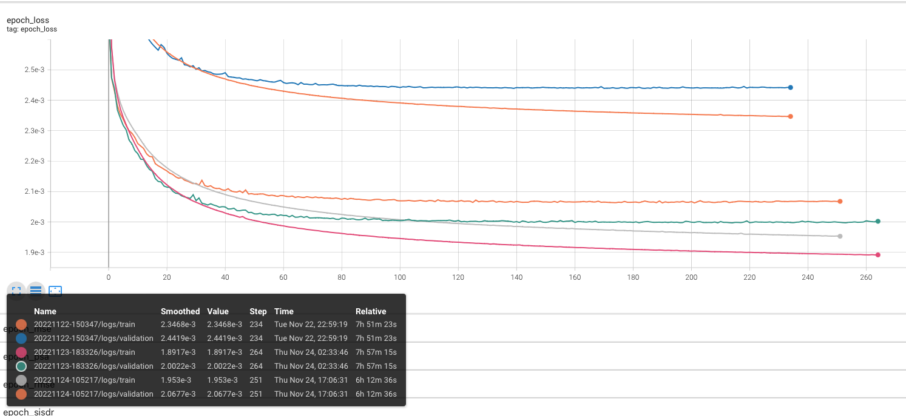
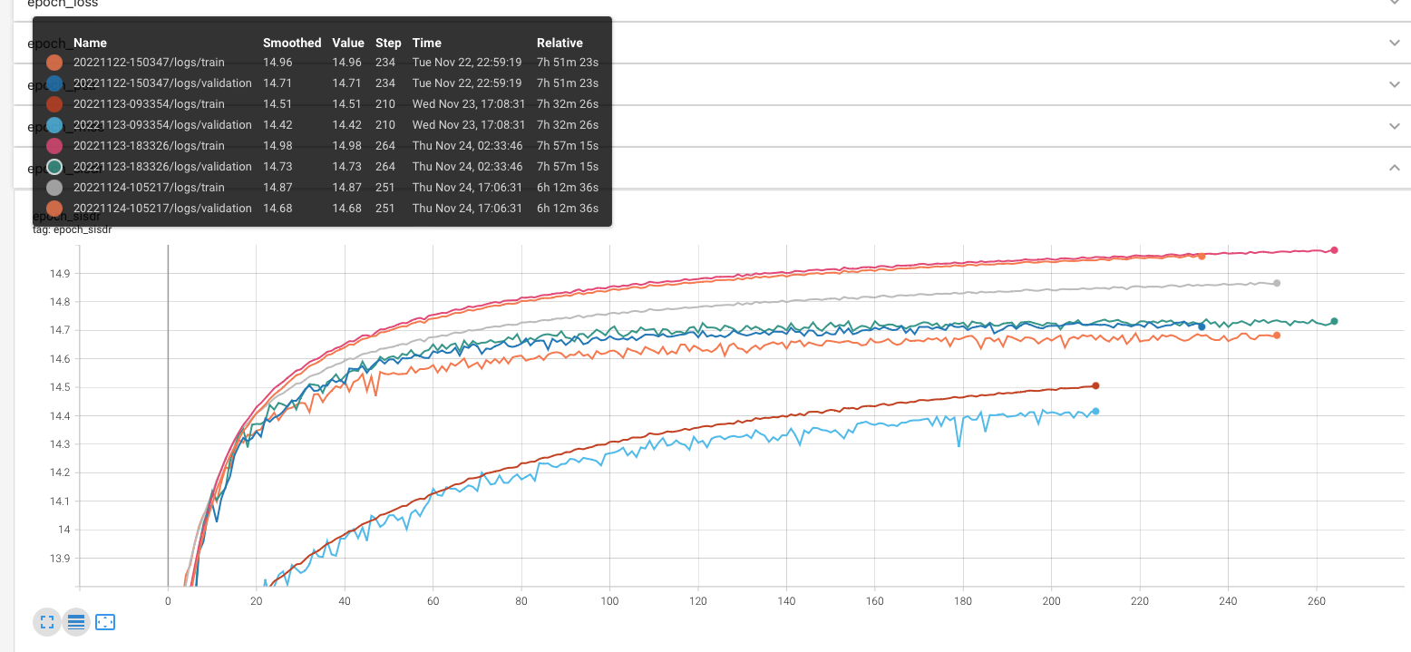
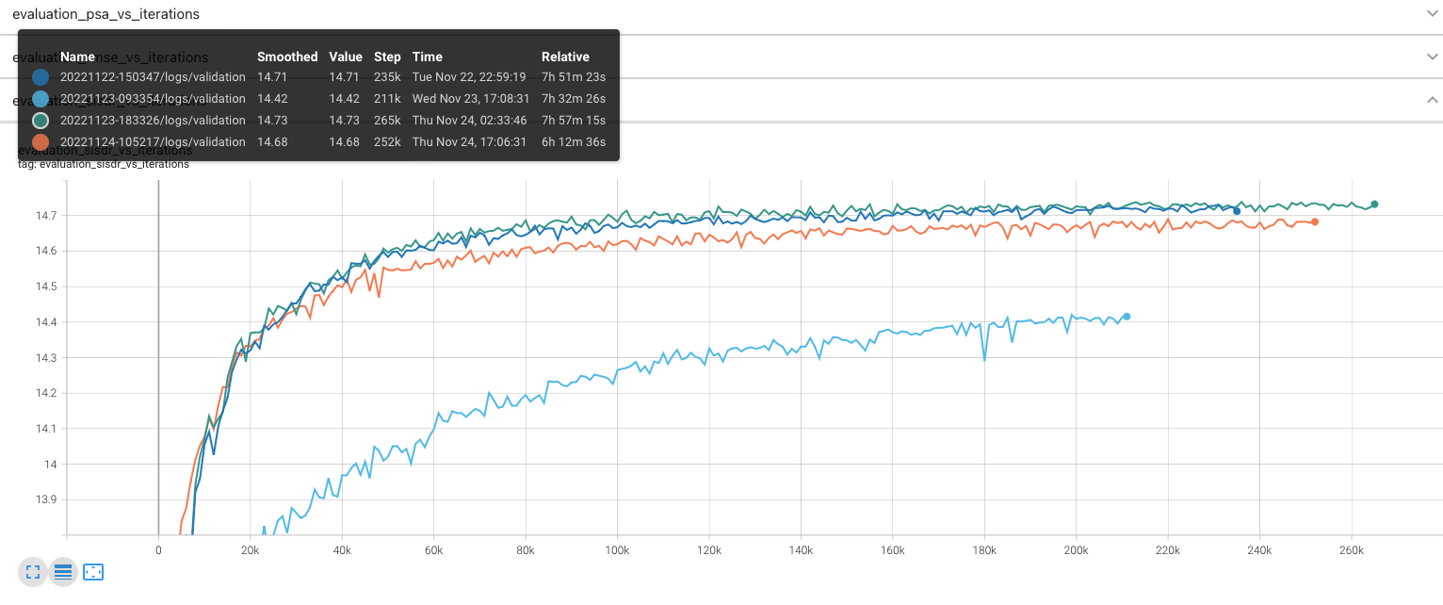
- rmse of stft : 20221122-150347
- mse of stft : 20221123-093354
- psa : 20221123-183326
- rmsa of amplitude : 20221124-105217
Loss function
RMSE(stft) vs MSE(stft) vs PSA vs RMSE(amplitude)
Loss, epoch
SISDR, epoch
SISDR, iteration

Slide 6
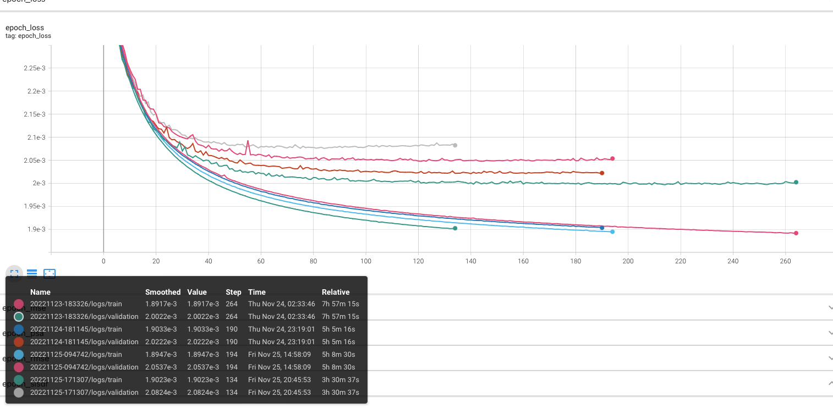
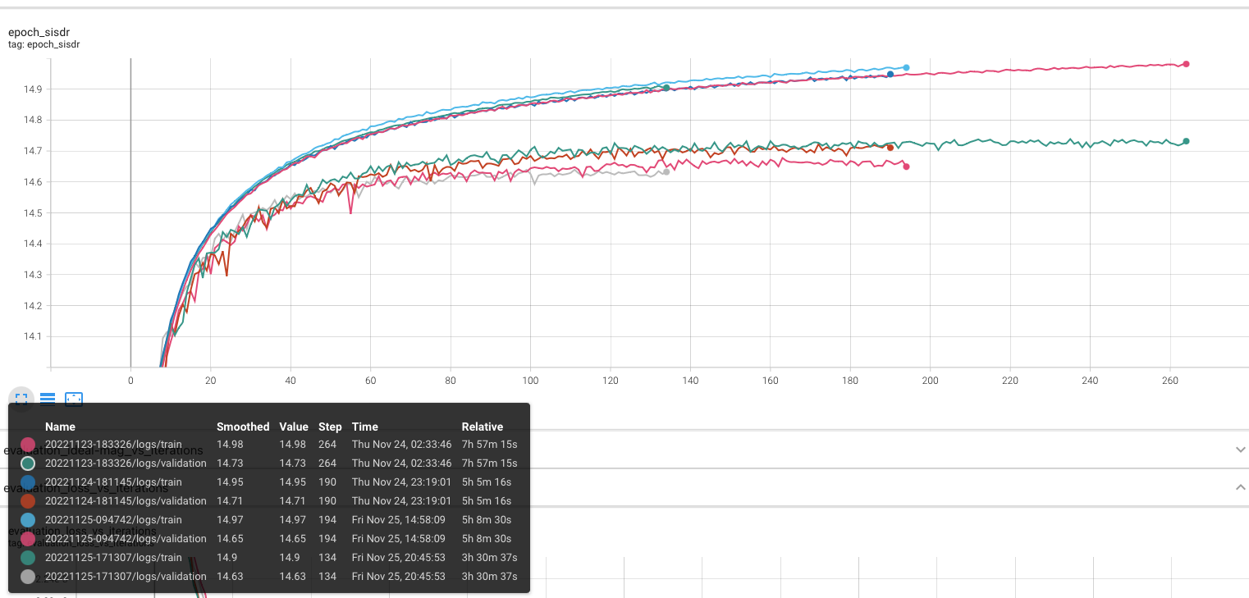
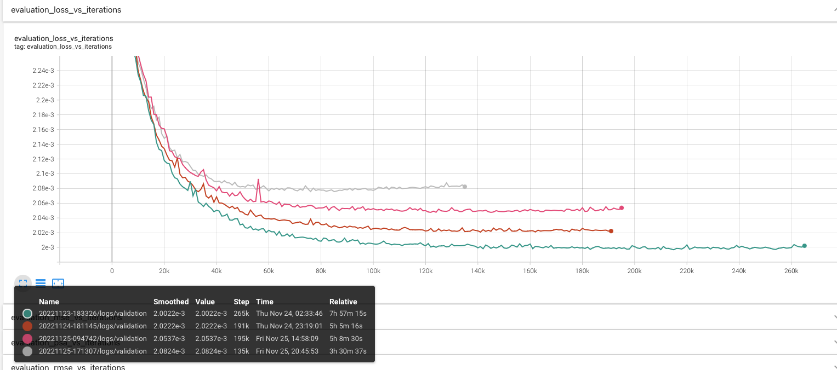
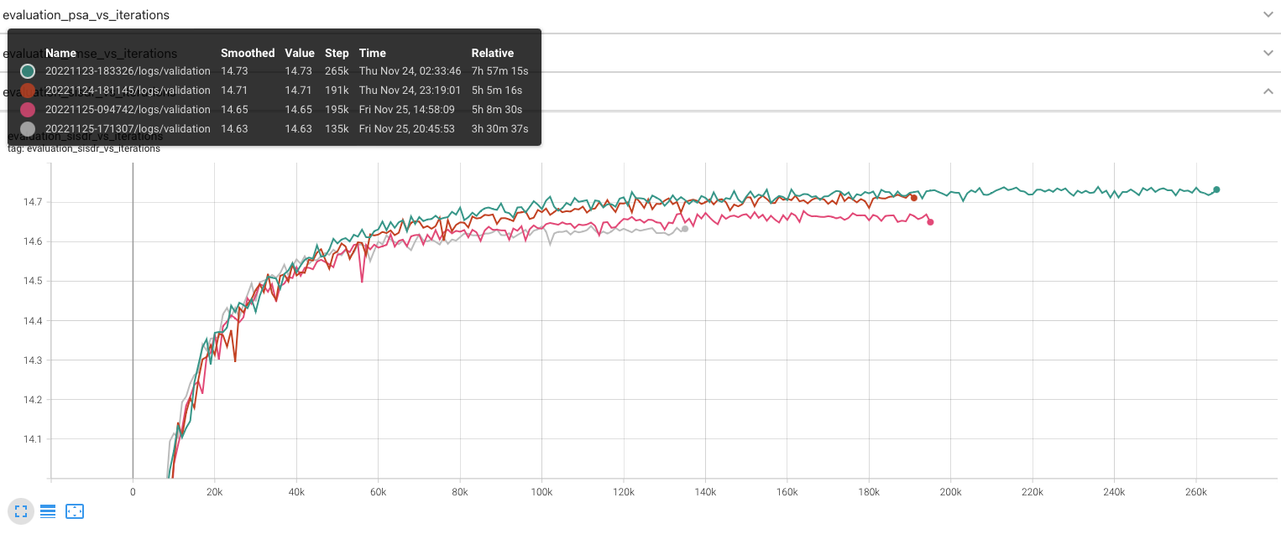
- 90:10: 20221123-183326
- 80:20: 20221124-181145
- 70:30: 20221125-094742
- 50:50: 20221125-171307
Train vs Validation Ratio
90:10, 80:20, 70:30, 50:50
Loss, epoch
SISDR, epoch
Loss, iteration
SISDR, iteration

Slide 7
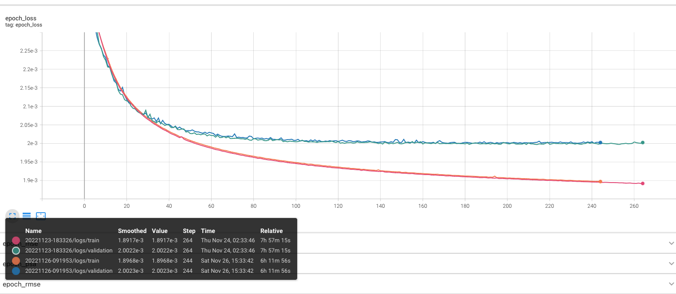
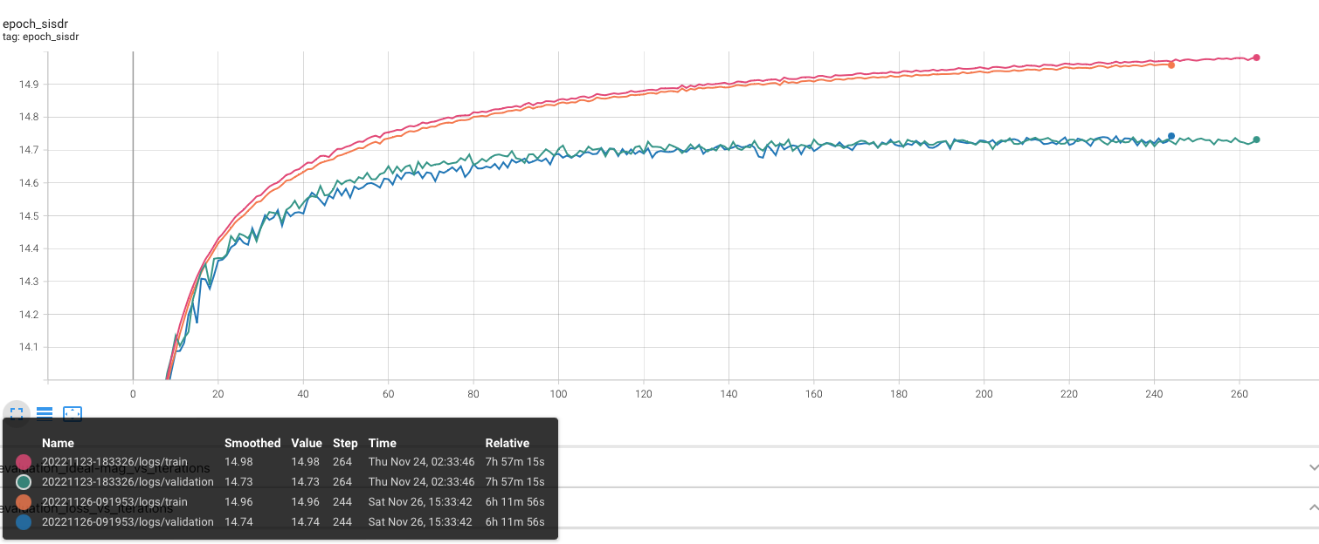
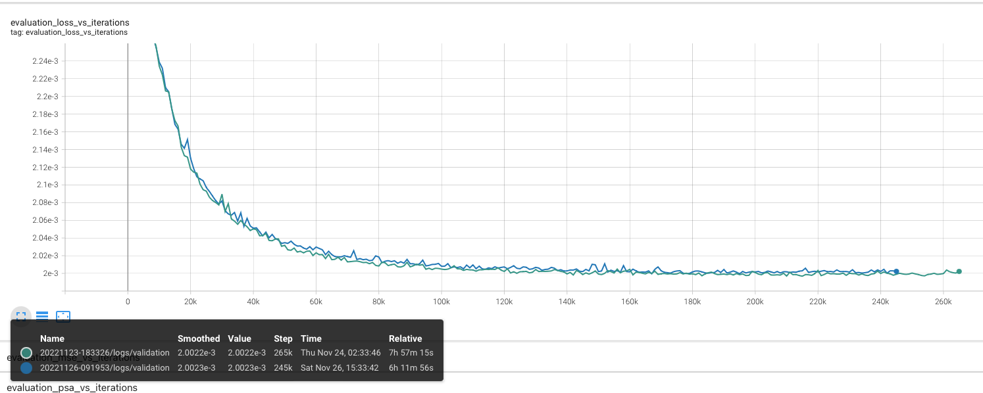
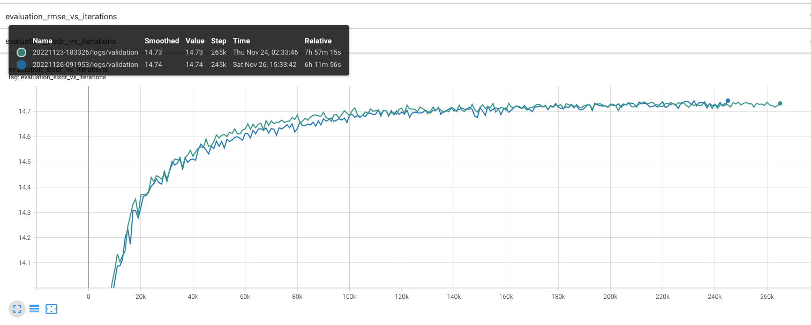
Dense layer initialization
O / X
20221123-183326 / 20221126-091953
Loss, epoch
SISDR, epoch
Loss, iteration
SISDR, iteration

Slide 8
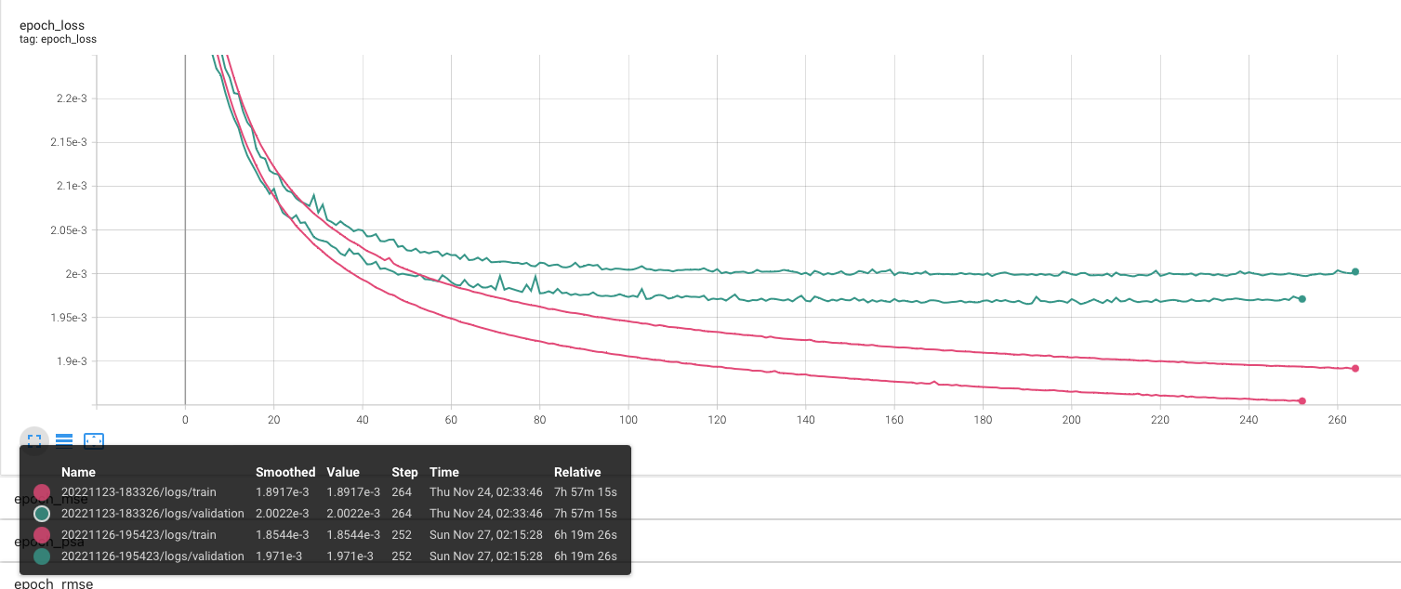
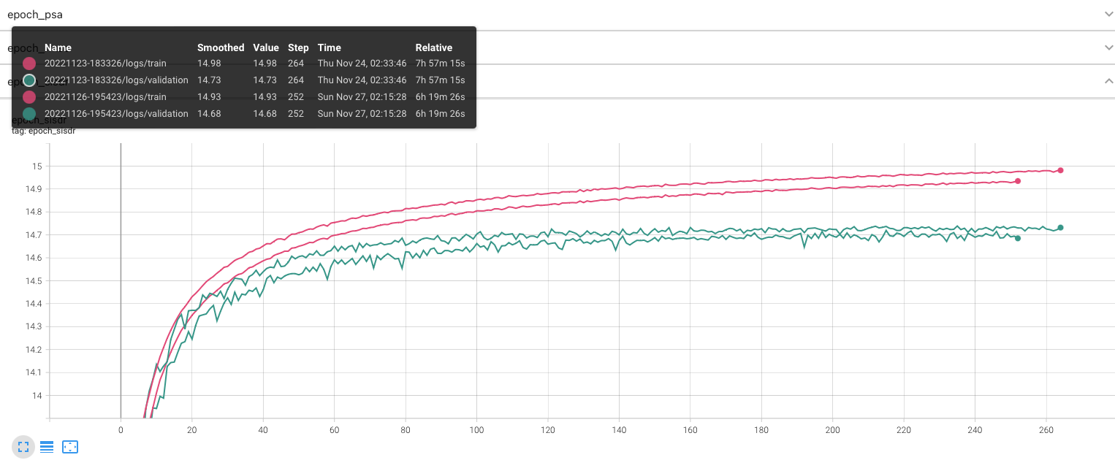
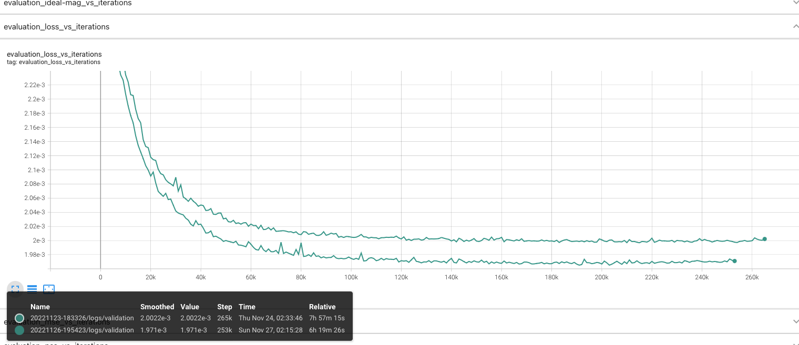
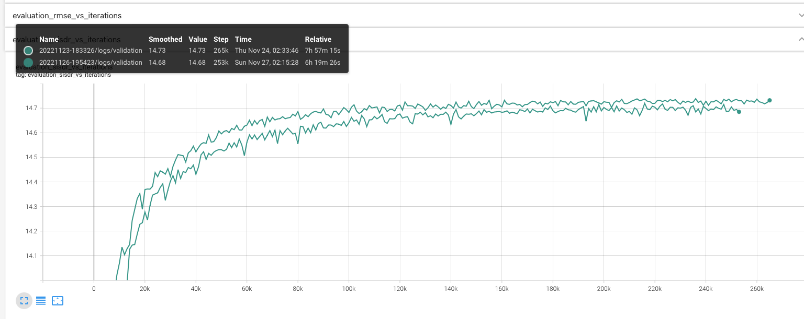
Time Period of Normalization
Entire / 1 sec
20221123-183326 / 20221126-195423
Loss, epoch
SISDR, epoch
Loss, iteration
SISDR, iteration

Slide 9
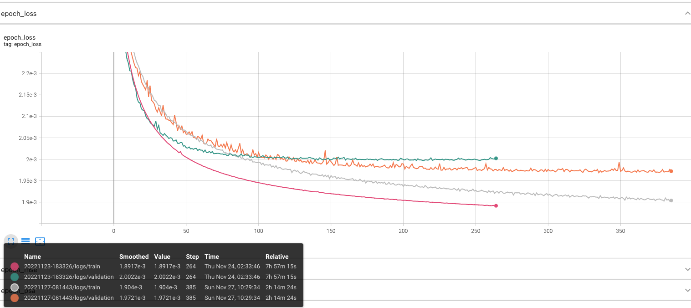
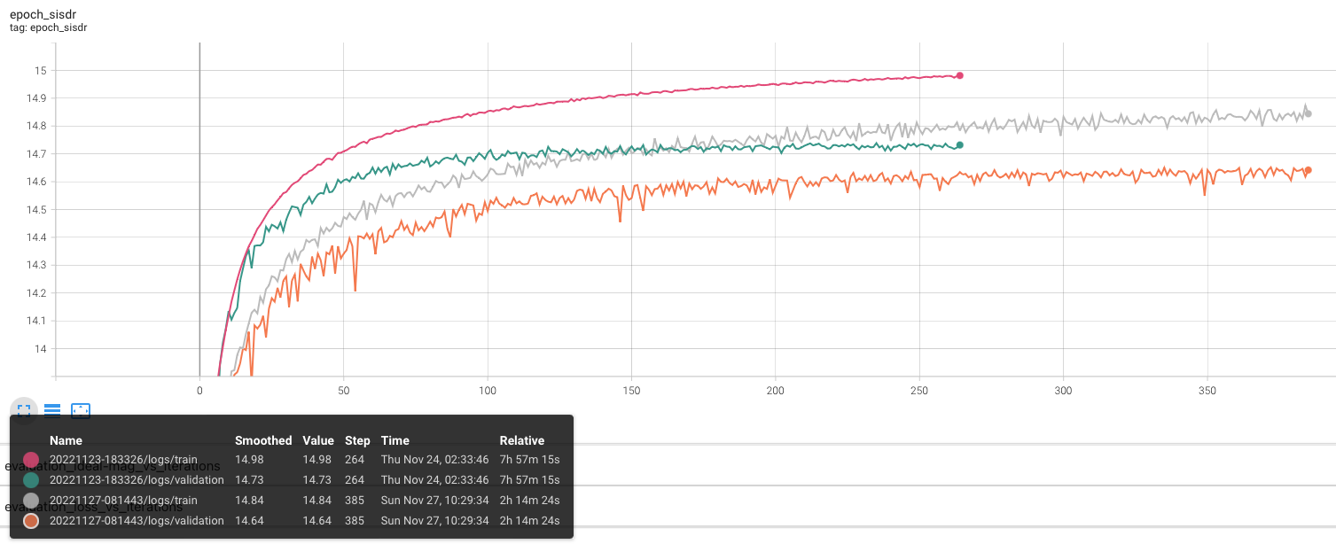
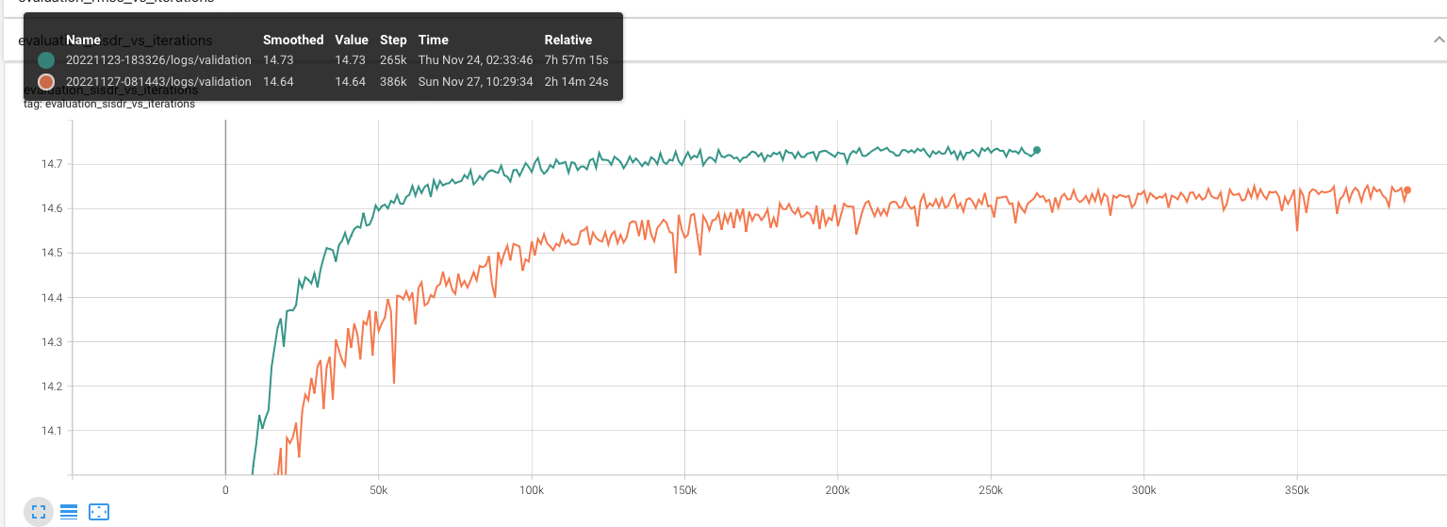
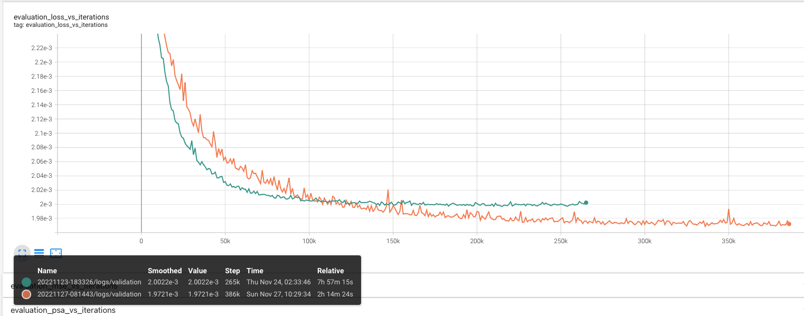
Batch size
512 / 64
20221123-183326 / 20221127-081443
Loss, epoch
SISDR, epoch
Loss, iteration
SISDR, iteration

Slide 10
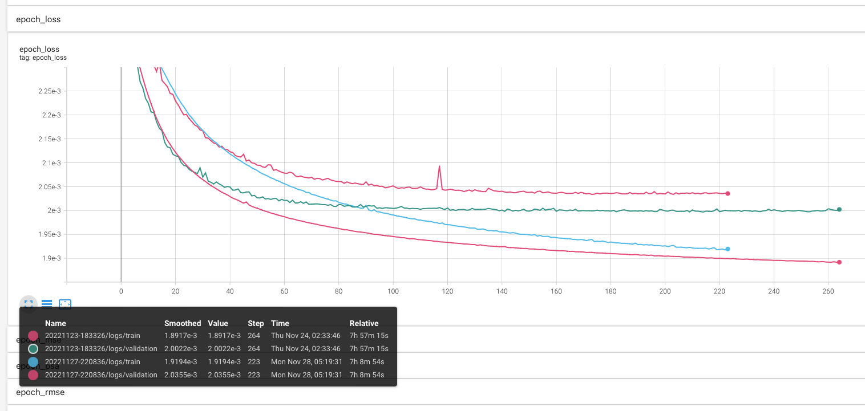
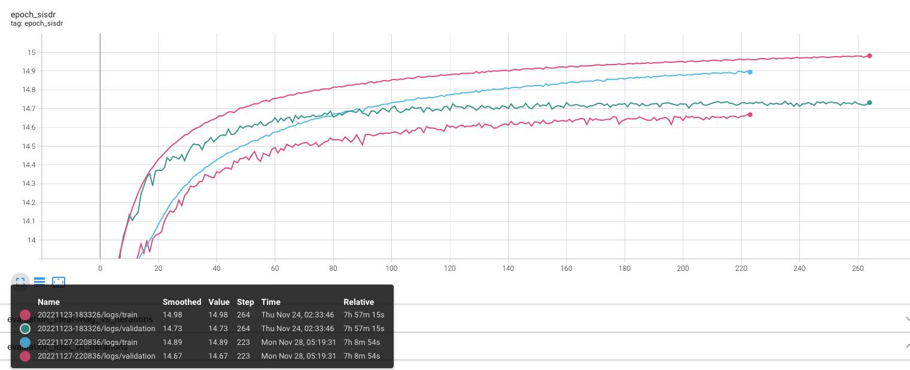
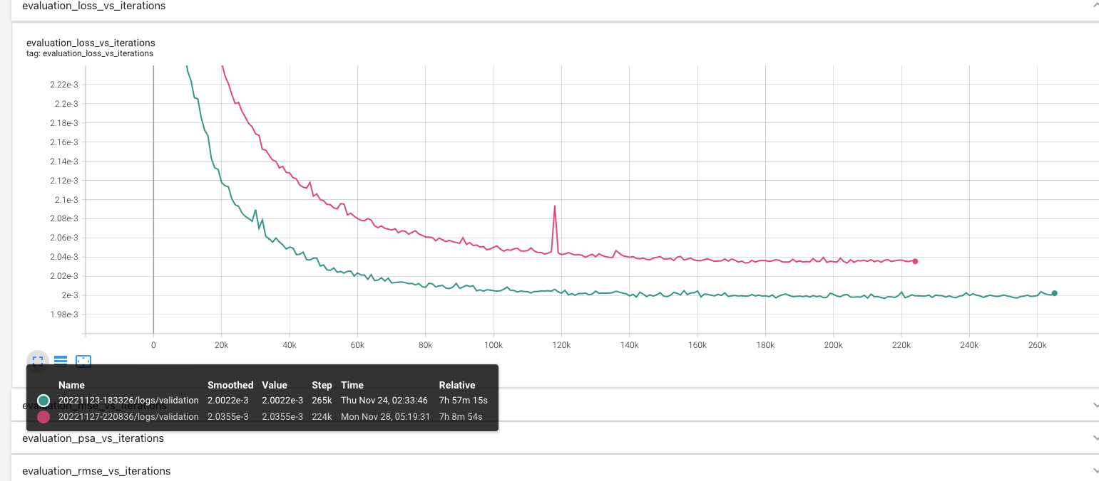
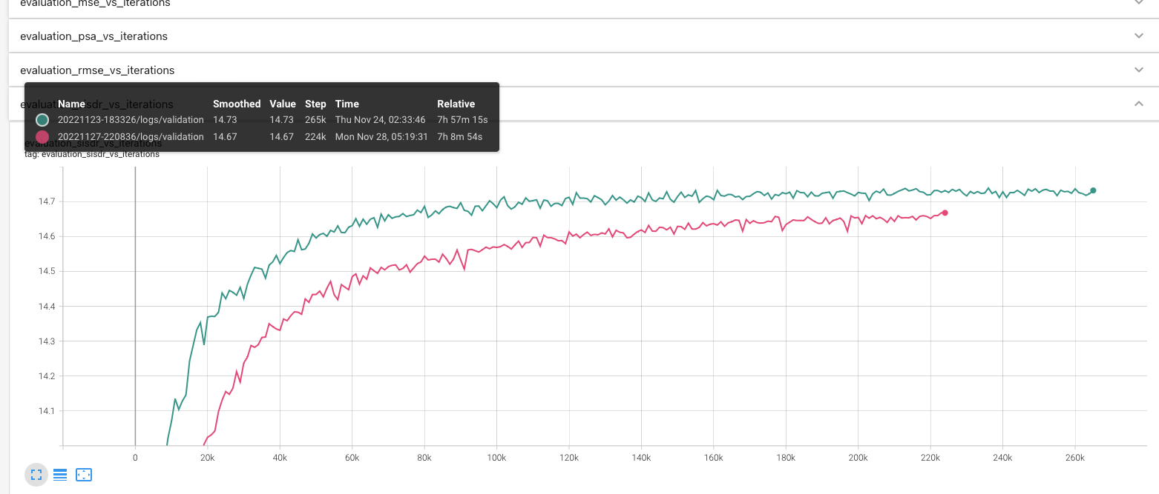
Batch Normalization
O / X
20221123-183326, 20221127-220836
Loss, epoch
SISDR, epoch
Loss, iteration
SISDR, iteration

Slide 11
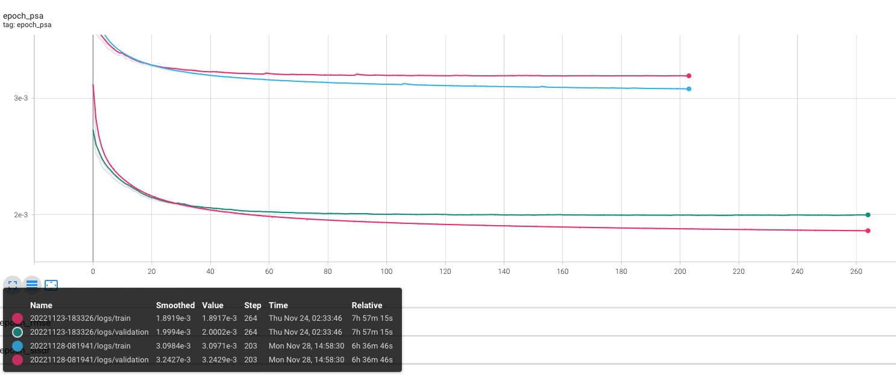
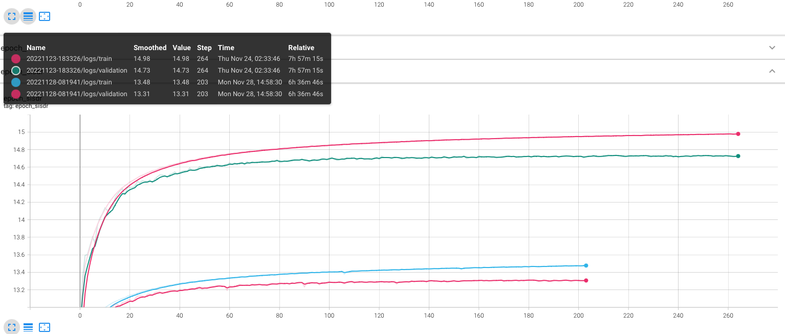
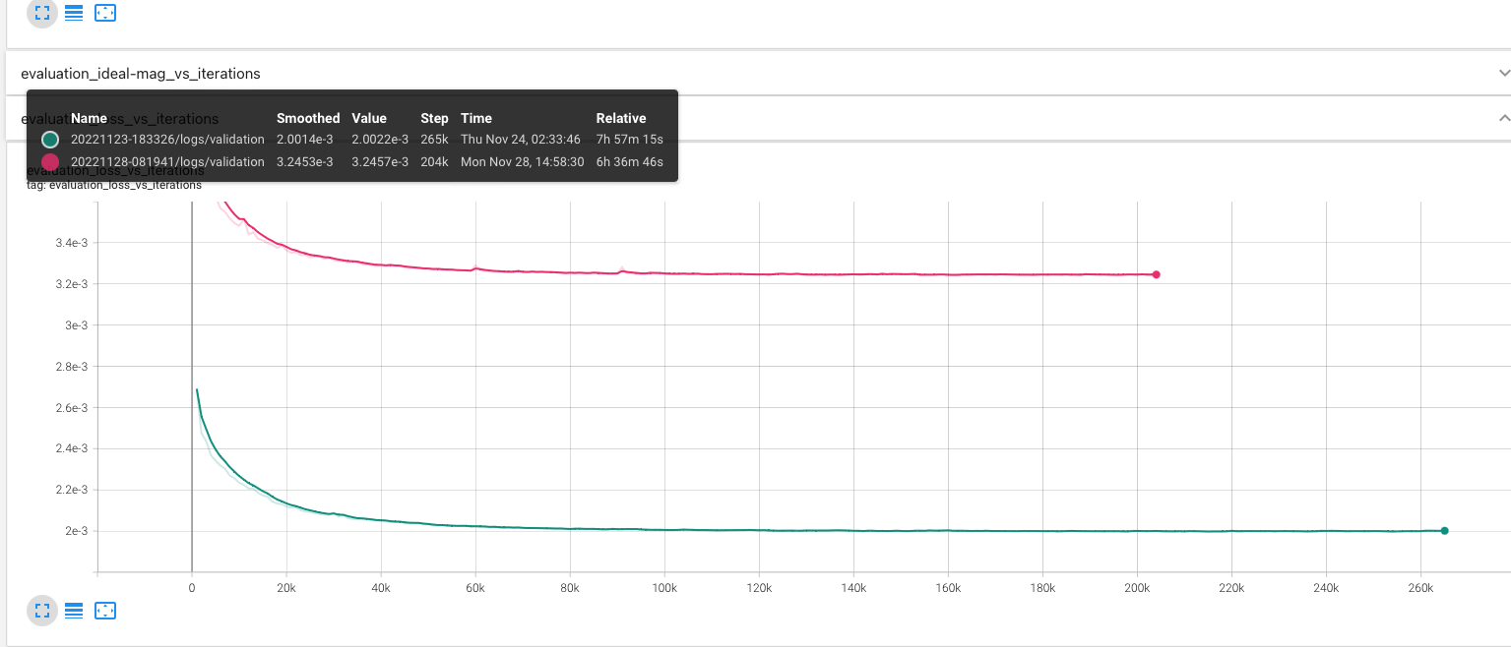
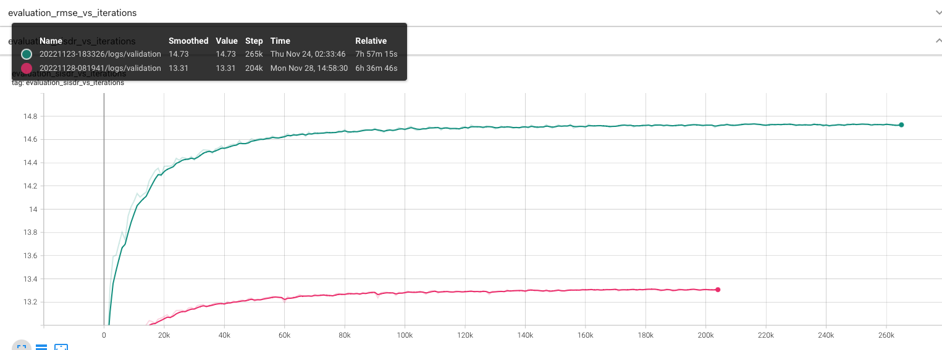
FFT Size
512 / 256
20221123-183326, 20221128-081941
Loss, epoch
SISDR, epoch
Loss, iteration
SISDR, iteration

Slide 12
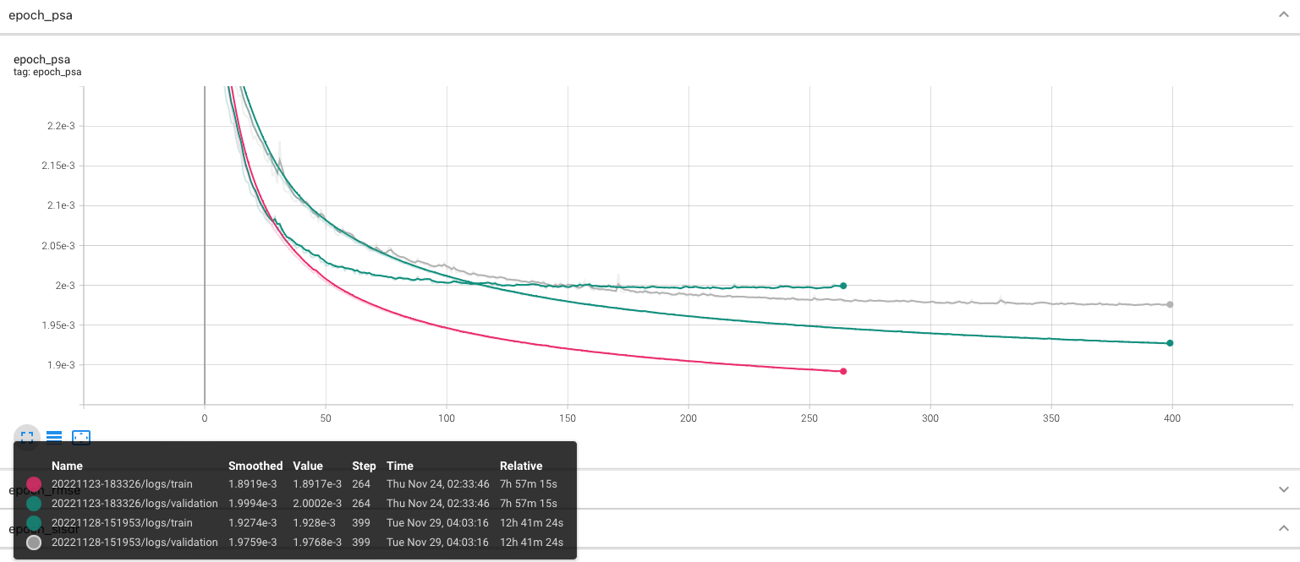
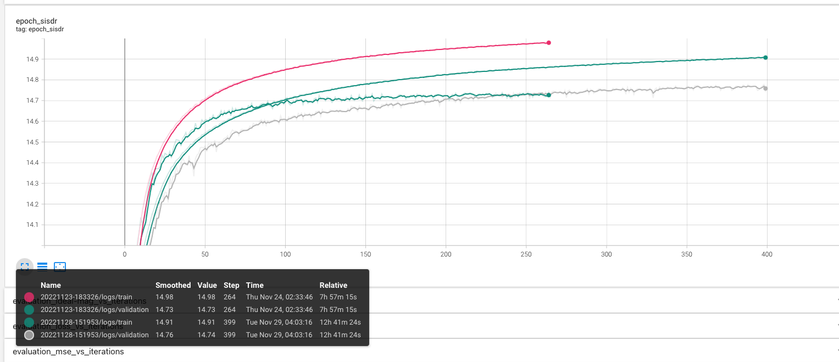
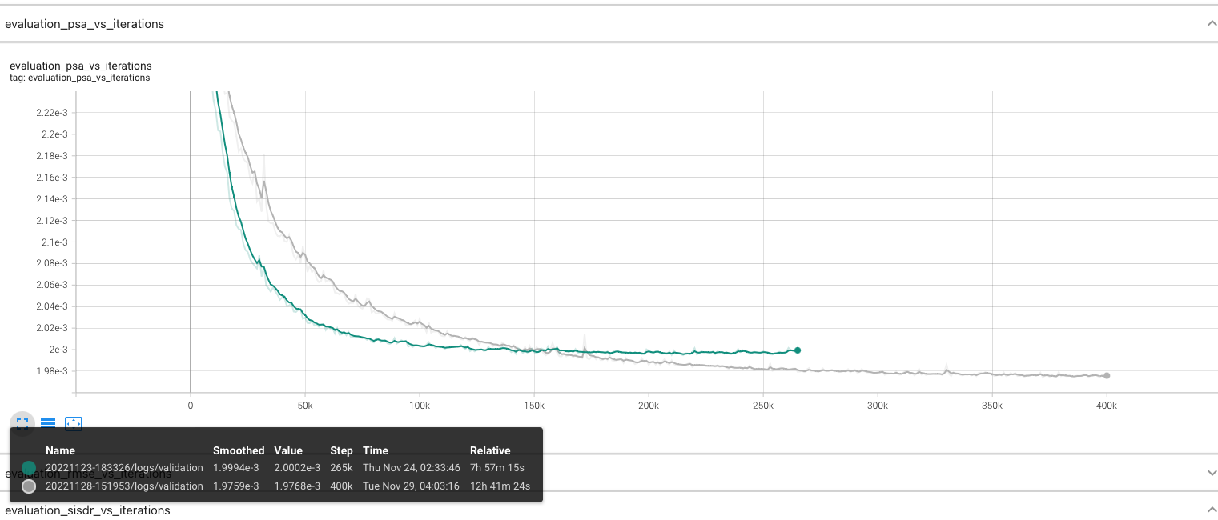
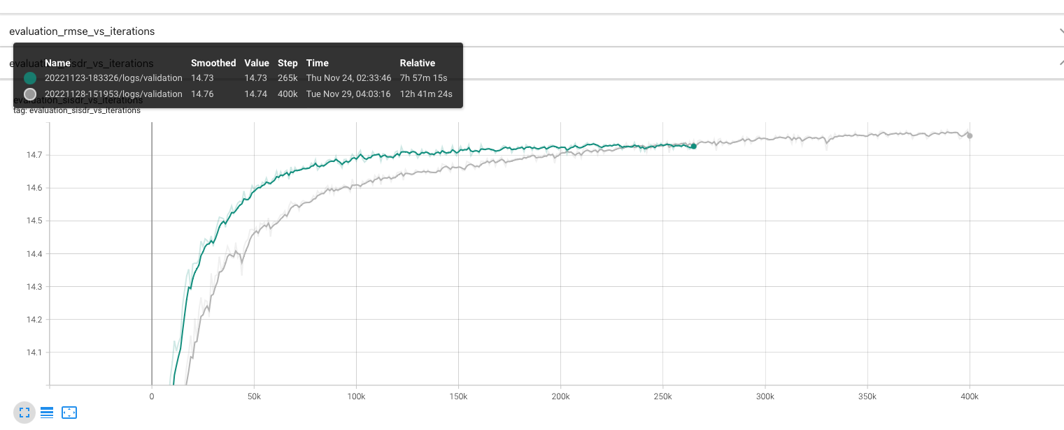
LSTM Layer
O / X
20221123-183326, 20221128-151953
Loss, epoch
SISDR, epoch
Loss, iteration
SISDR, iteration

Slide 13
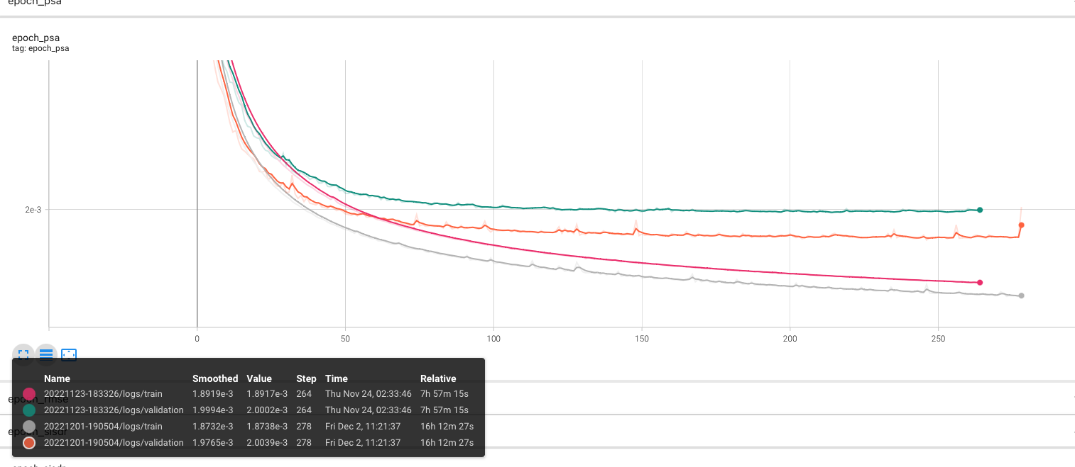
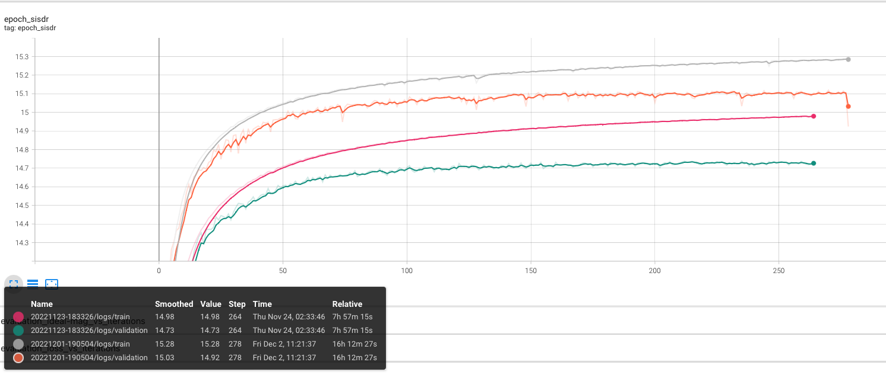
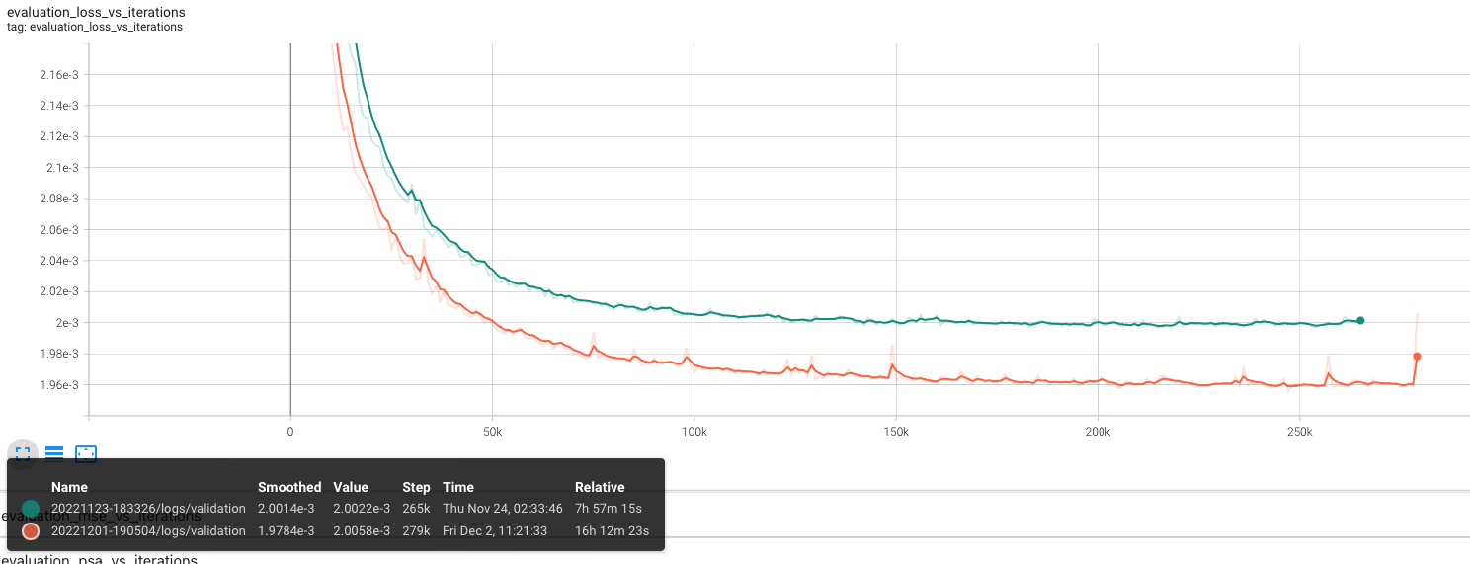
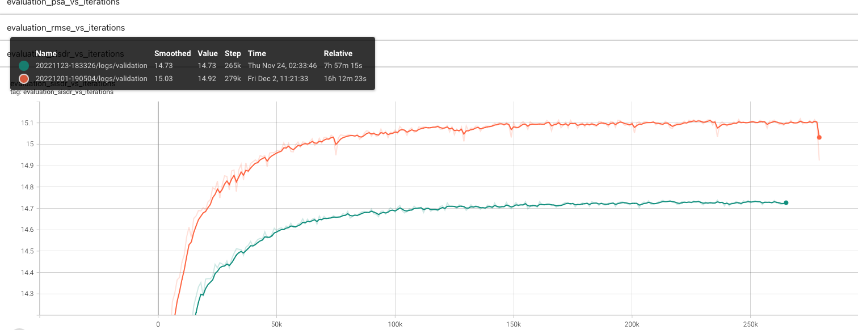
Hop size
256 / 128
20221123-183326, 20221201-190504
Loss, epoch
SISDR, epoch
Loss, iteration
SISDR, iteration

Slide 14
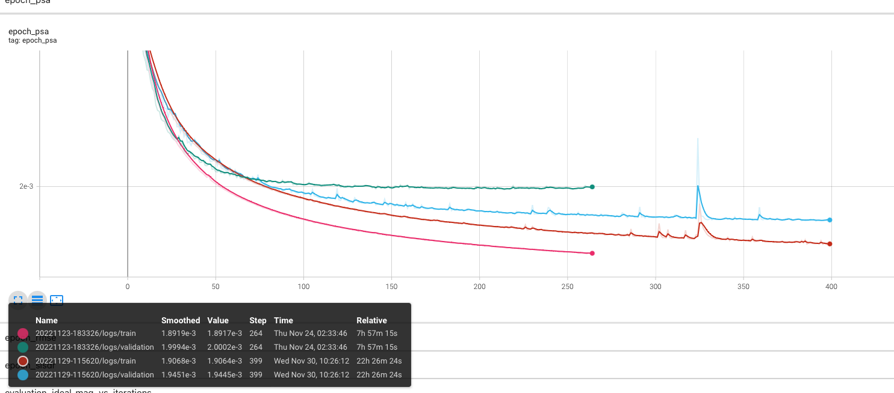
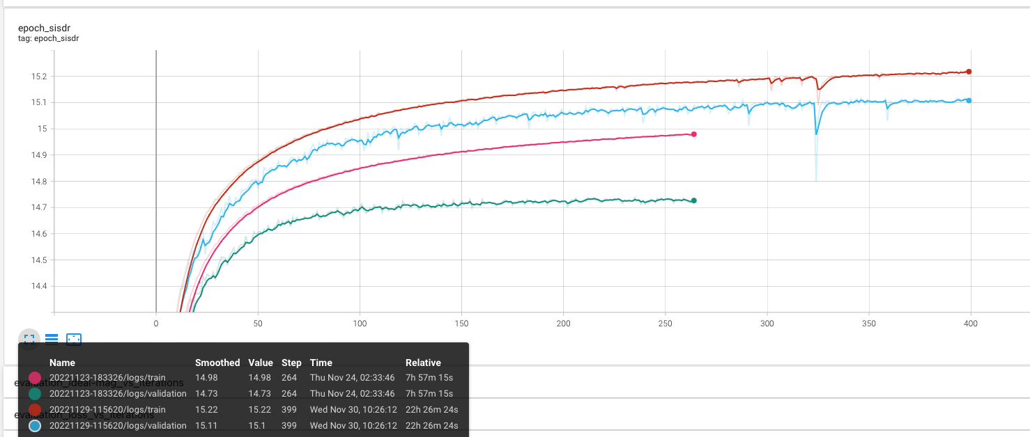
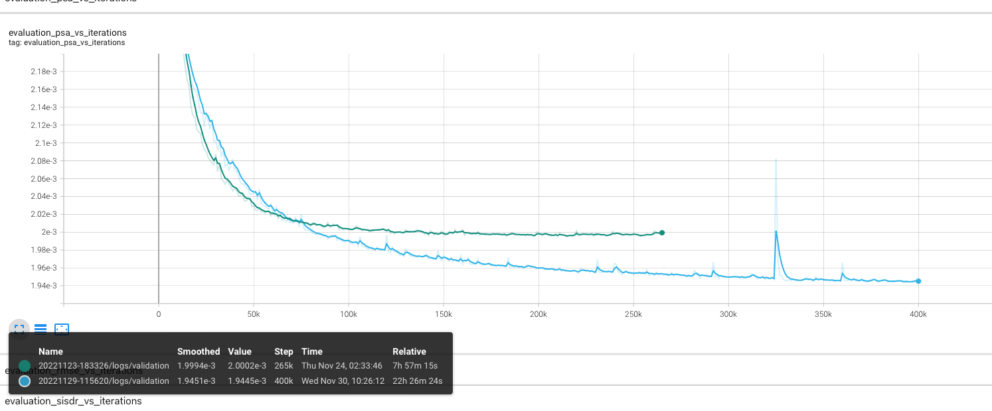
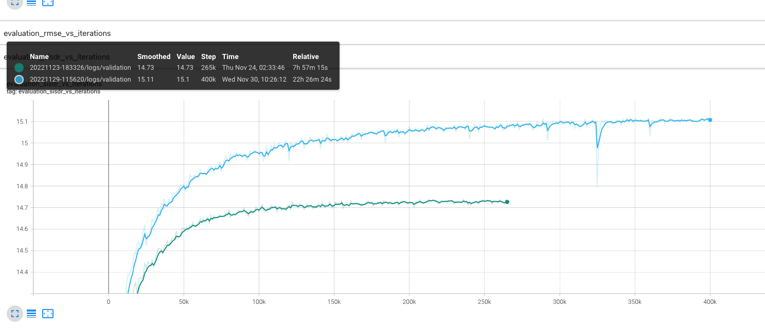
LSTM layer + Hop size
256,256 / 128, 128
20221123-183326, 20221129-115620
Loss, epoch
SISDR, epoch
Loss, iteration
SISDR, iteration

Slide 15
Detail
Train vs Validation Ratio
90:10, 80:20, 70:30, 50:50

Slide 16
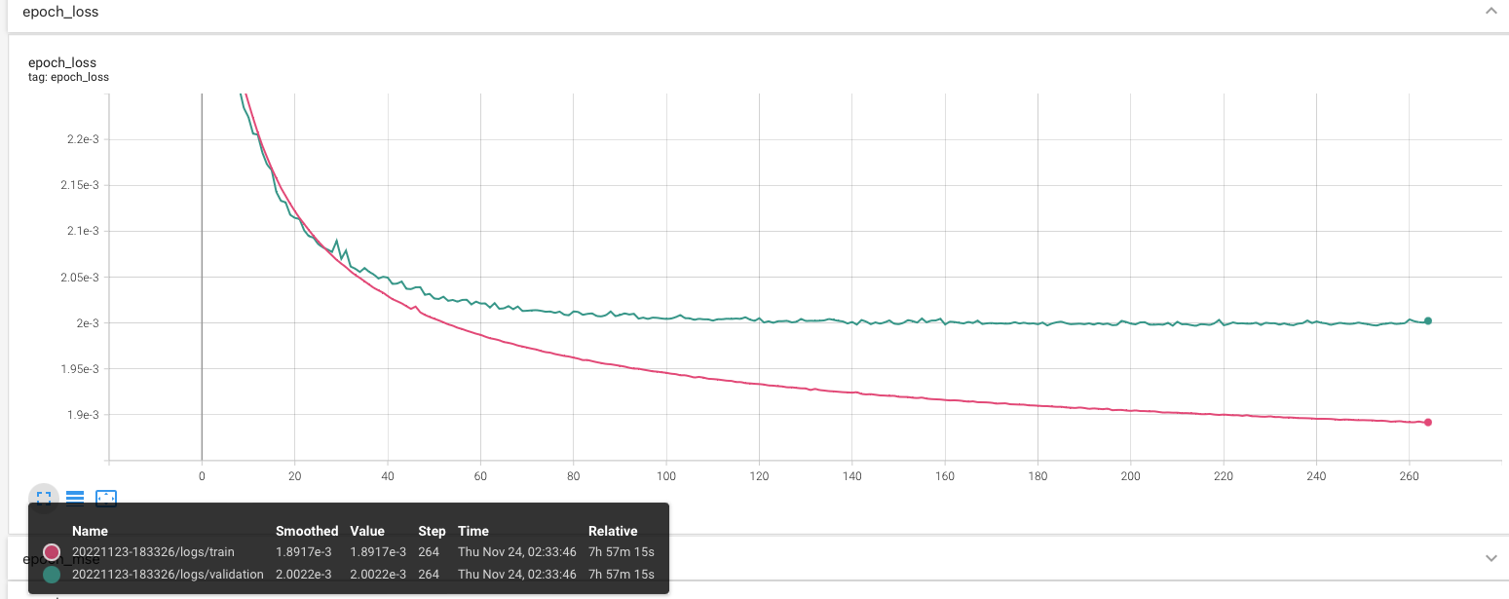
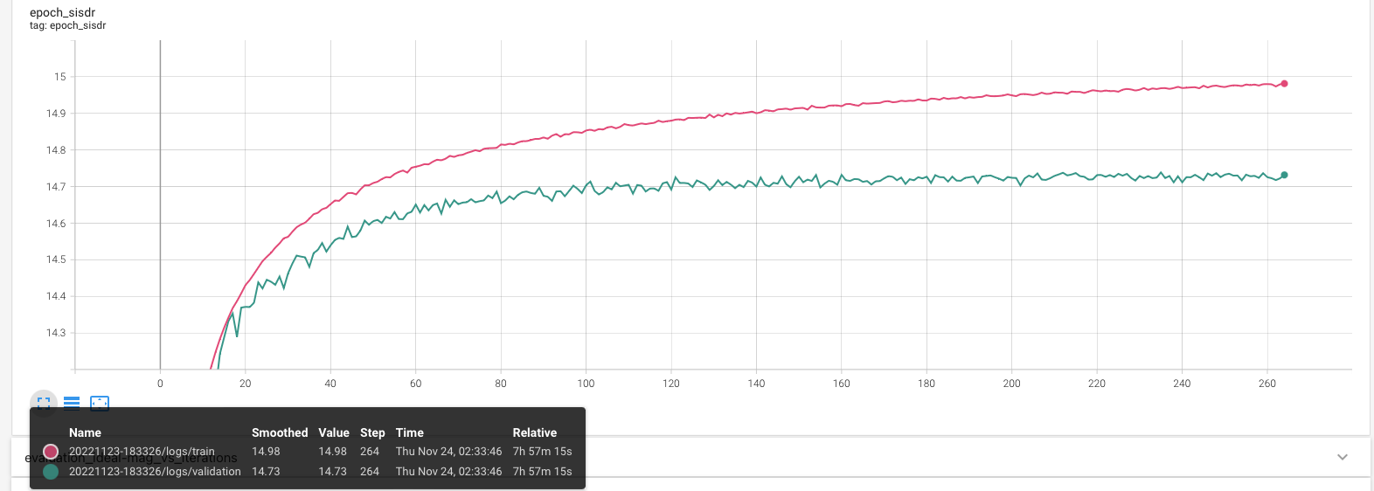
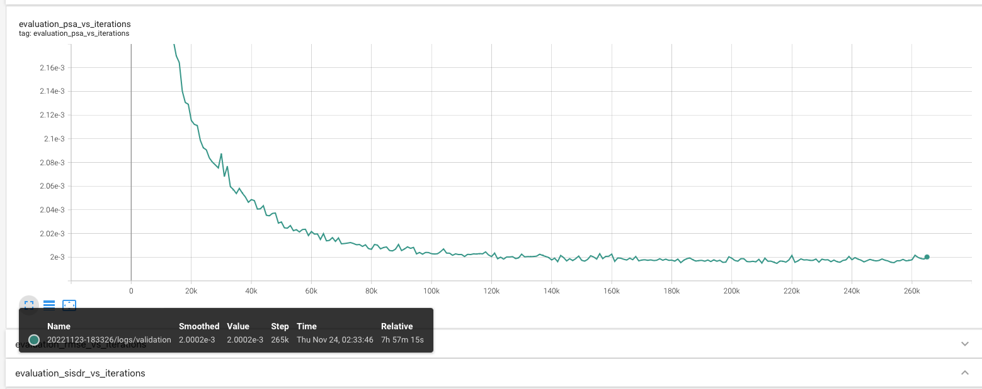
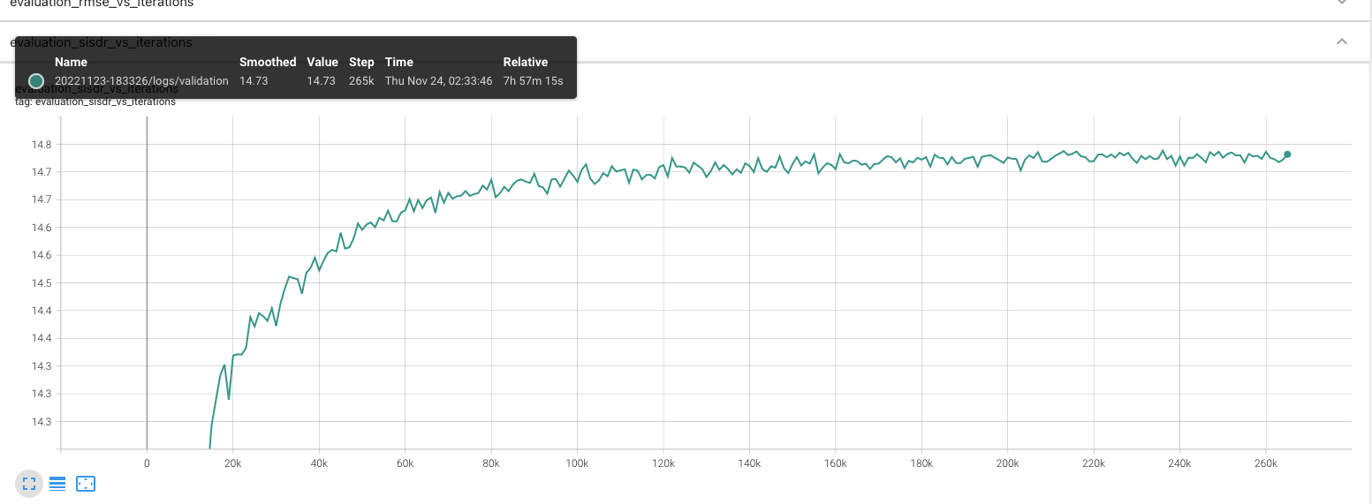
90:10
20221123-183326
Loss, epoch
SISDR, epoch
Loss, iteration
SISDR, iteration

Slide 17
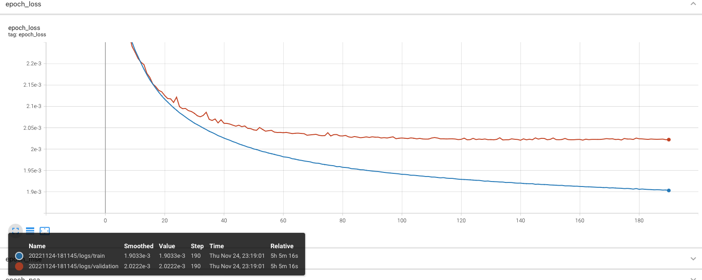
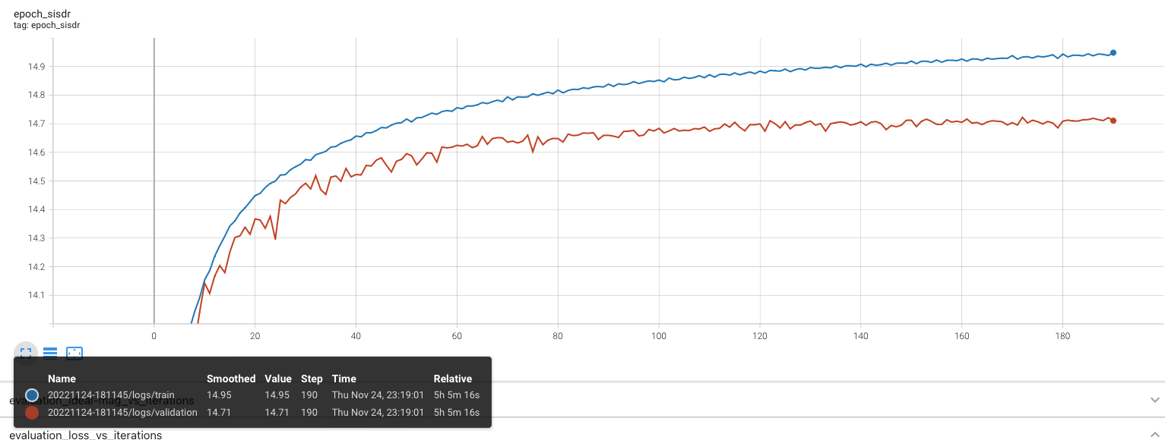
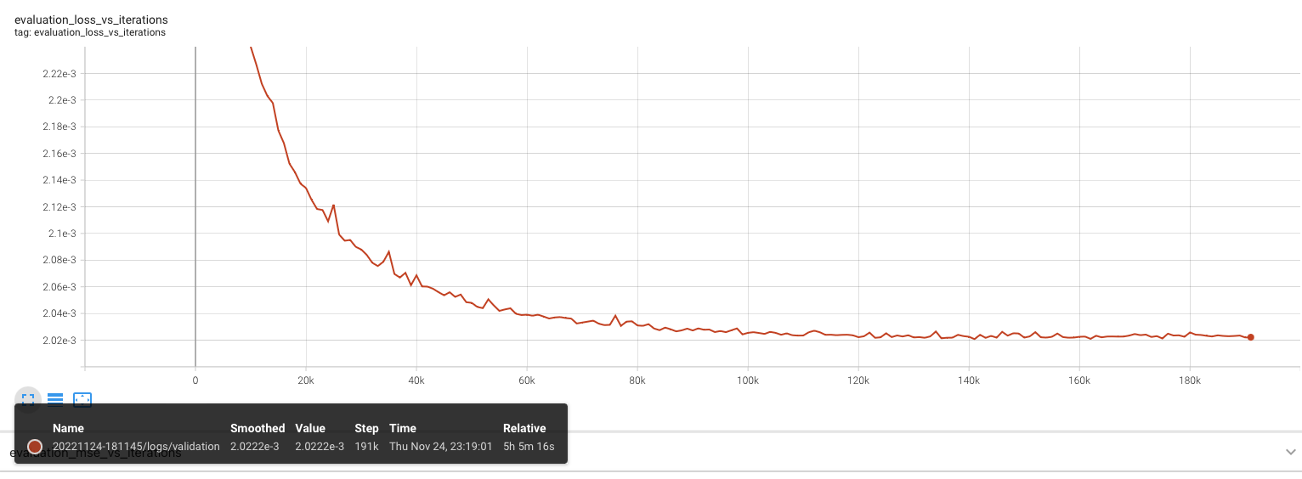
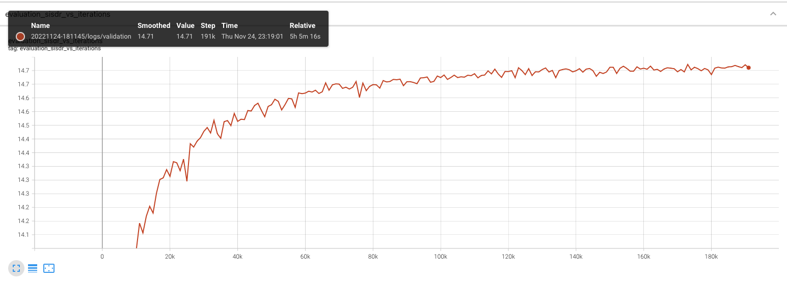
80:20
20221124-181145
Loss, epoch
SISDR, epoch
Loss, iteration
SISDR, iteration

Slide 18
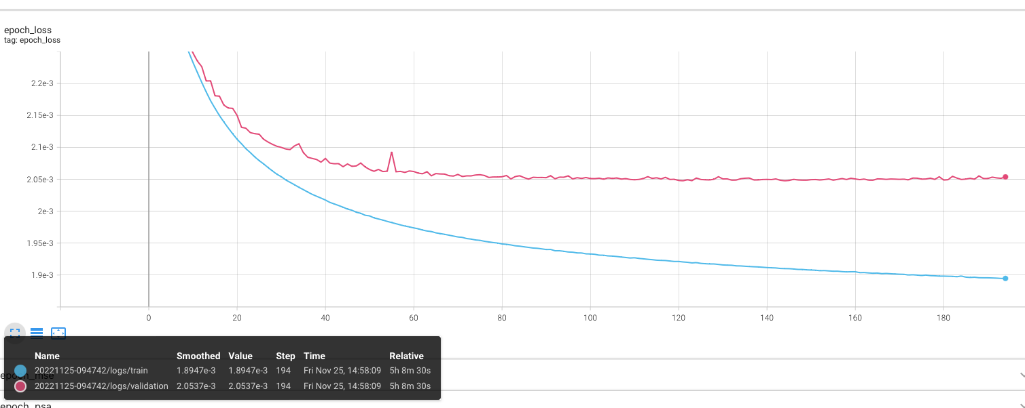
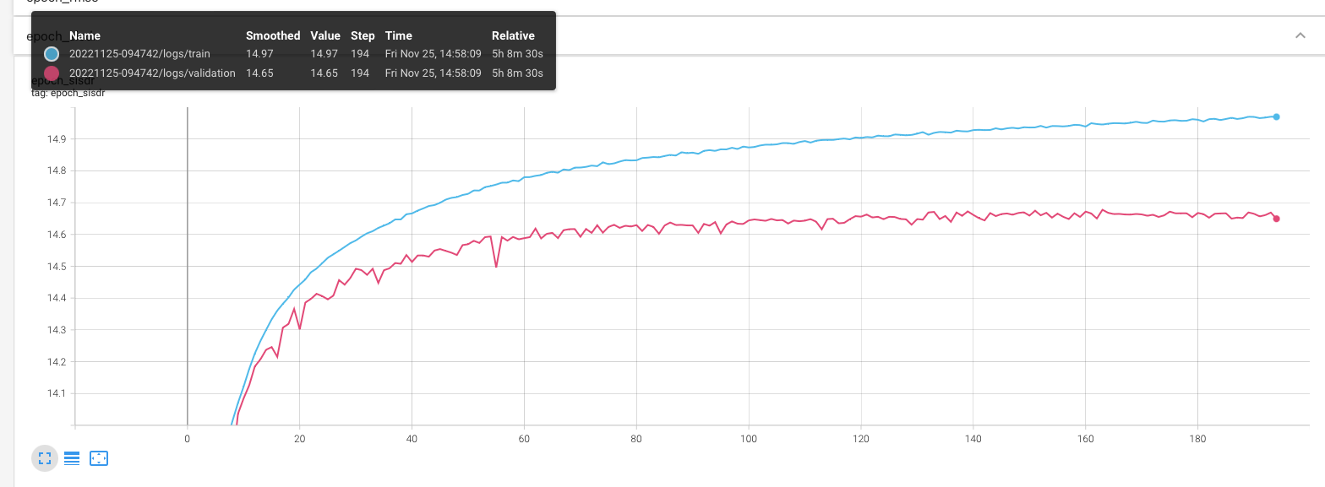
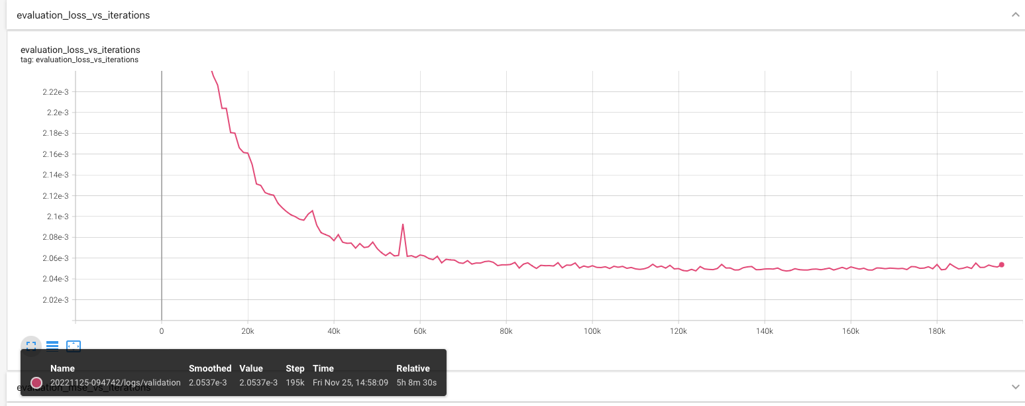

70:30
20221125-094742
Loss, epoch
SISDR, epoch
Loss, iteration
SISDR, iteration

Slide 19




50:50
20221125-171307
Loss, epoch
SISDR, epoch
Loss, iteration
SISDR, iteration

Slide 20
Detail
Loss function
RMSE(stft) vs MSE(stft) vs PSA vs RMSE(amplitude)

Slide 21




RMSE(stft)
20221122-150347
Loss, epoch
SISDR, epoch
Loss, iteration
SISDR, iteration

Slide 22




MSE(stft)
221123-093354
Loss, epoch
SISDR, epoch
Loss, iteration
SISDR, iteration

Slide 23
PSA
20221123-183326
Loss, epoch
SISDR, epoch
Loss, iteration
SISDR, iteration

Slide 24




RMSE(amplitude)
20221124-105217
Loss, epoch
SISDR, epoch
Loss, iteration
SISDR, iteration

